Slide 1
Database Management Systems
LECTURE -1

Slide 2
What is a Database

Slide 3
Database Definitions
A database is a shared collection of logically related data that is stored to meet the requirements of different users of an organization
A database is a self-describing collection of integrated records

Slide 4
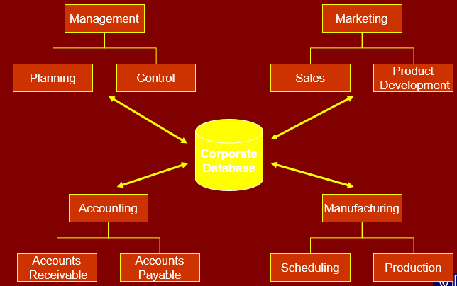
The concept of a shared organizational database

Slide 5
A bit of History
Computer initially used for computational/ engineering purposes
Commercial applications introduced File Processing System

Slide 6
File Processing System
A collection of programs that perform services for the end-users such as production of reports

Slide 7
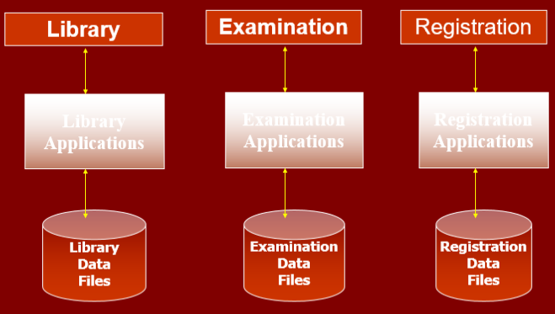
File Processing Systems
Program and Data Interdependence

Slide 8
File Processing Systems
Library
Examination
Registration
Reg_Number
Reg_Number
Reg_Number
Name
Name
Name
Father Name
Address
Father Name
Books Issued
Class
Phone
Fine
Semester
Address
Grade
Class
Duplication of Data
Vulnerable to Inconsistency

Slide 9
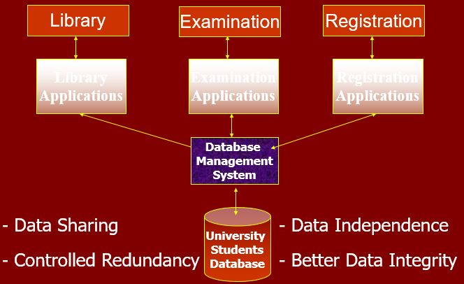
Advantages of Database Approach

Slide 10
Disadvantages
Higher costs
Conversion cost
More difficult recovery

Slide 11
Database System Important Terms
Schema
Database Application
Database Management system(DBMS)

Slide 12
Data As Resource
Resource
Any asset that is of value to an organization and that incurs cost

Slide 13
Levels of Data
Real-world data ( Entity)
Metadata ( Record Type)
Data Occurrence ( Record of an Entity)

Slide 14
Database Users
Application Programmers
End Users
Naïve
Sophisticated

Slide 15
Database Users
Database Administrator (DBA)
A person who has central control over data and programs that access this data

Slide 16
Functions of DBA
Schema definition
Granting data access
Routine Maintenance
Backups
Monitoring disk space
Monitoring jobs running

Slide 17
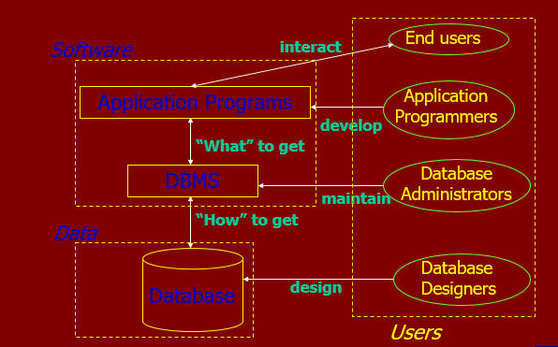
Data, Database, Data Model and DBMS

Slide 18
Common Terms
Data
Information
Database Management system (DBMS)

Slide 19
Database Management Systems
LECTURE -1
END

